Slide 1
P0 Presentation
Christian Romero

Slide 2
Functionality
search customers by name
place orders to store locations for customers
display all order history of a customer
add a new customer
display details of an order
input validation
exception handling
display all order history of a store location

Slide 3
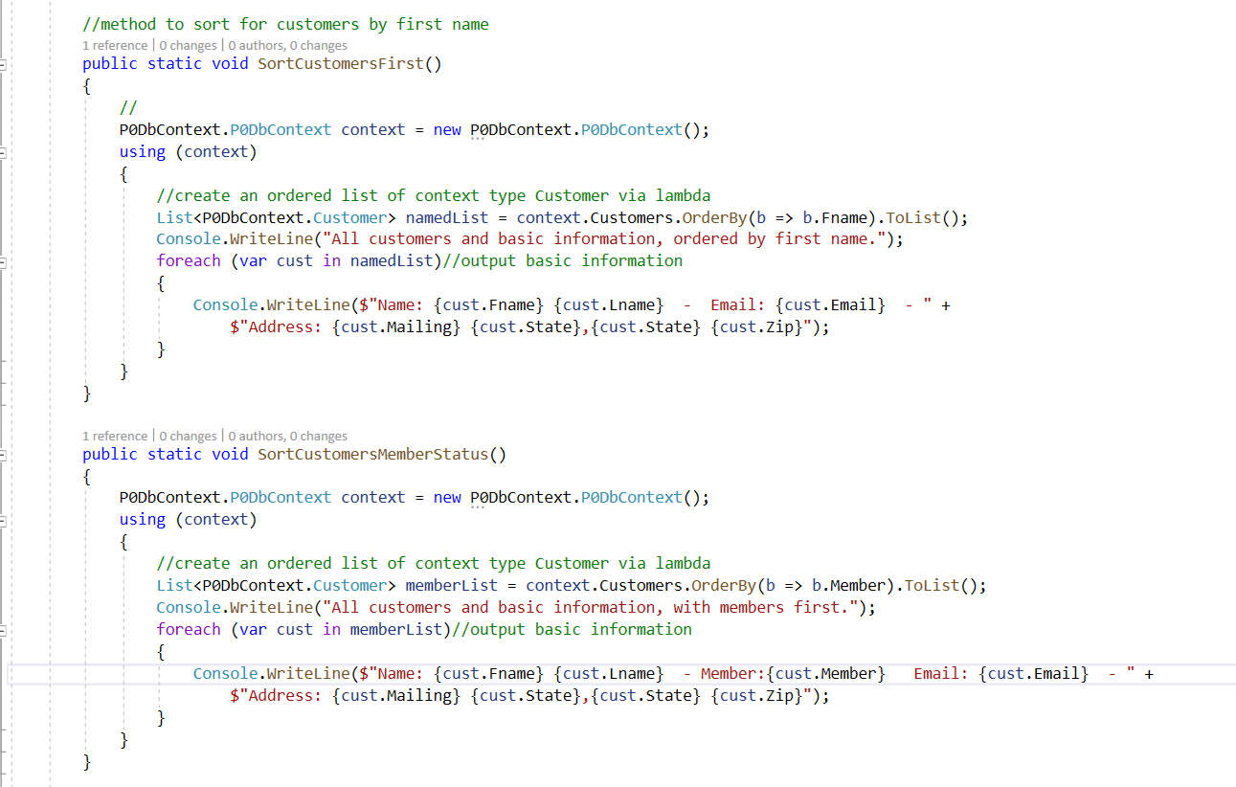
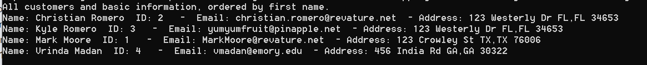
Search customers by name (& other parameters)

Slide 4
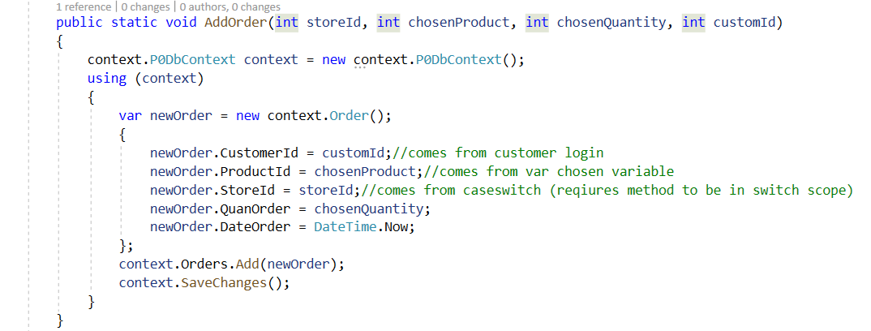
Place orders to store locations for customers

Slide 5
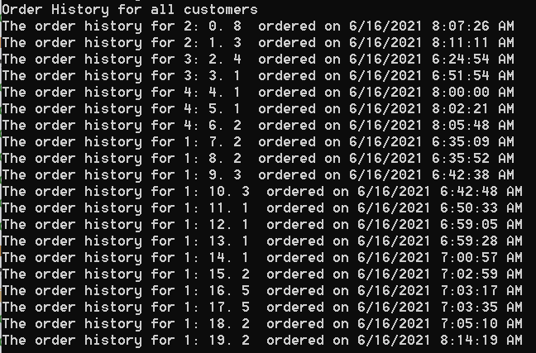
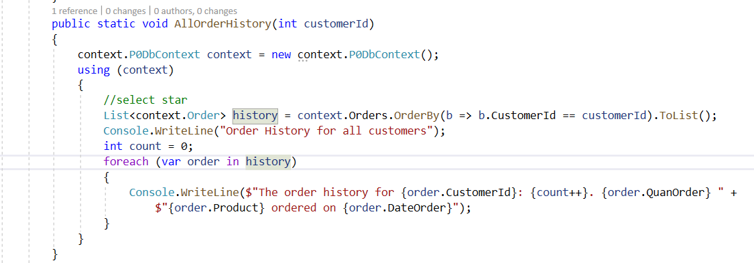
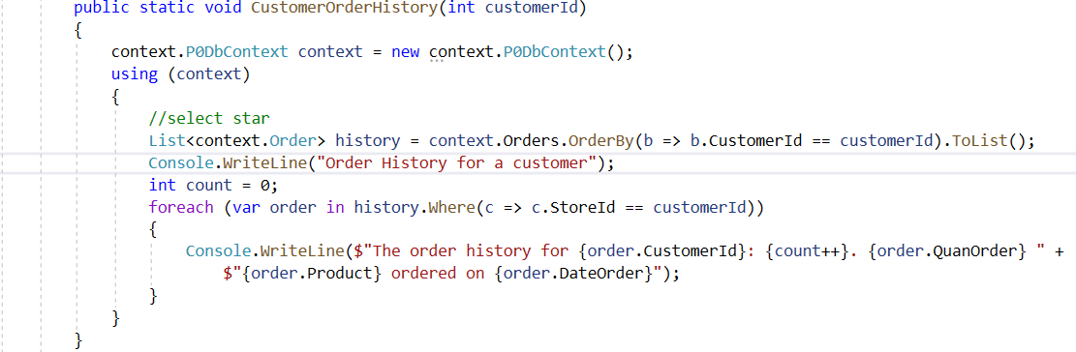
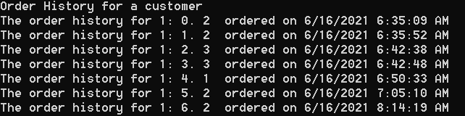
Display all order history of a customer

Slide 6
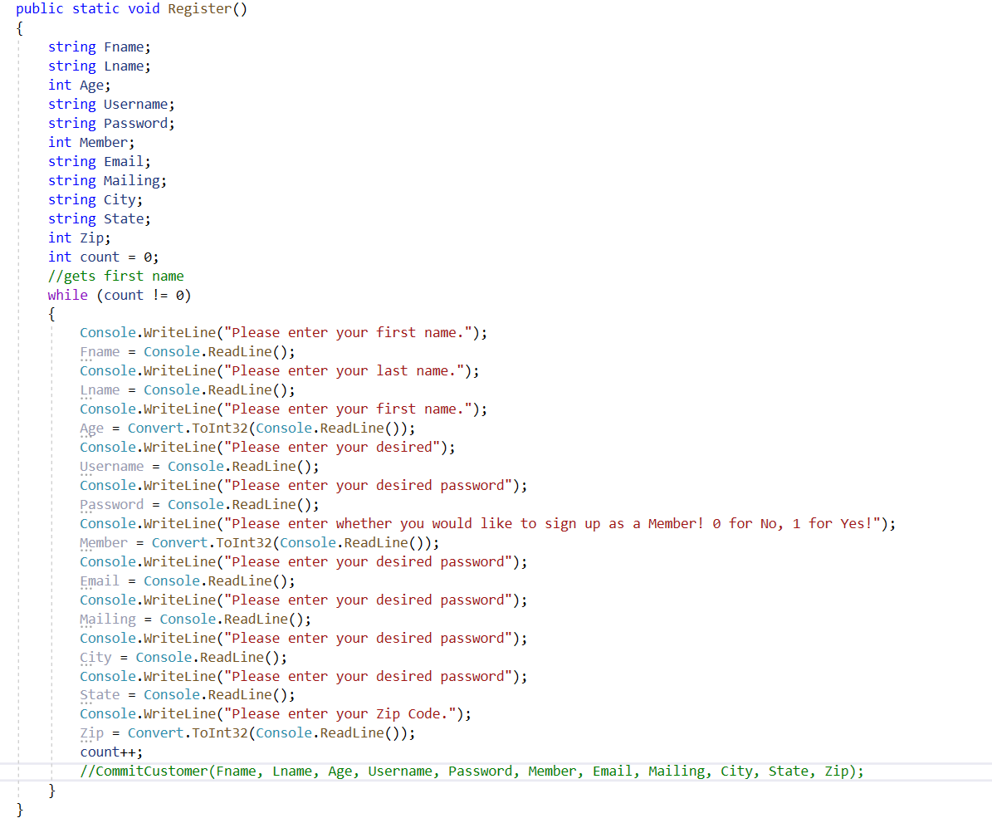
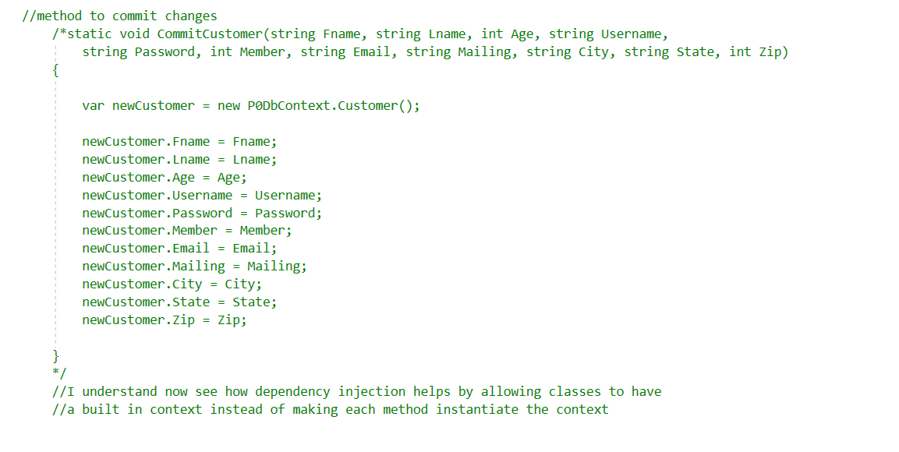
Add a new customer

Slide 7
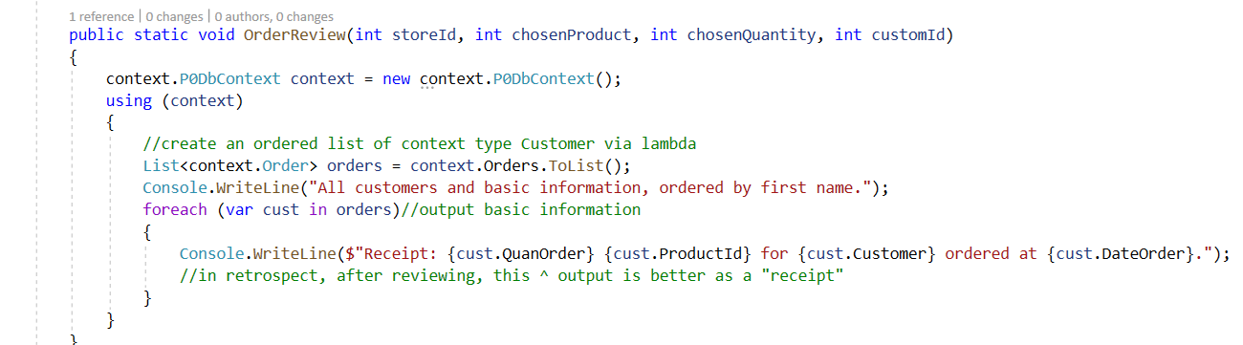
Display details of an order

Slide 8
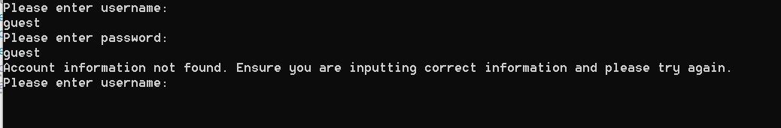

Input Validation

Slide 9
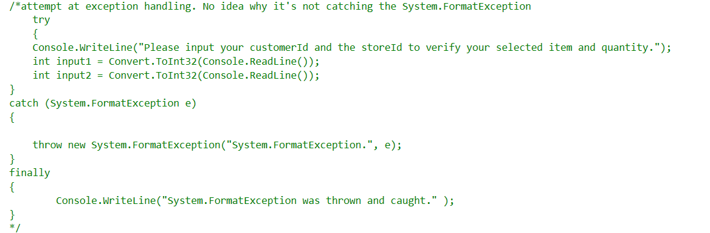
Exception Handling

Slide 10
Design
EF Core w/ Db Approach
Db 3rd Normal Form
Locations have an inventory
“Solution Design”
Domain classes
Db Access library
BusLogic project
Interfaces for helper classes
persistent data (to a DB); no hardcoding of data.(prices, customers, order history, etc.)
XML comments
Inventory deprementation
10 Unit testing methods

Slide 11
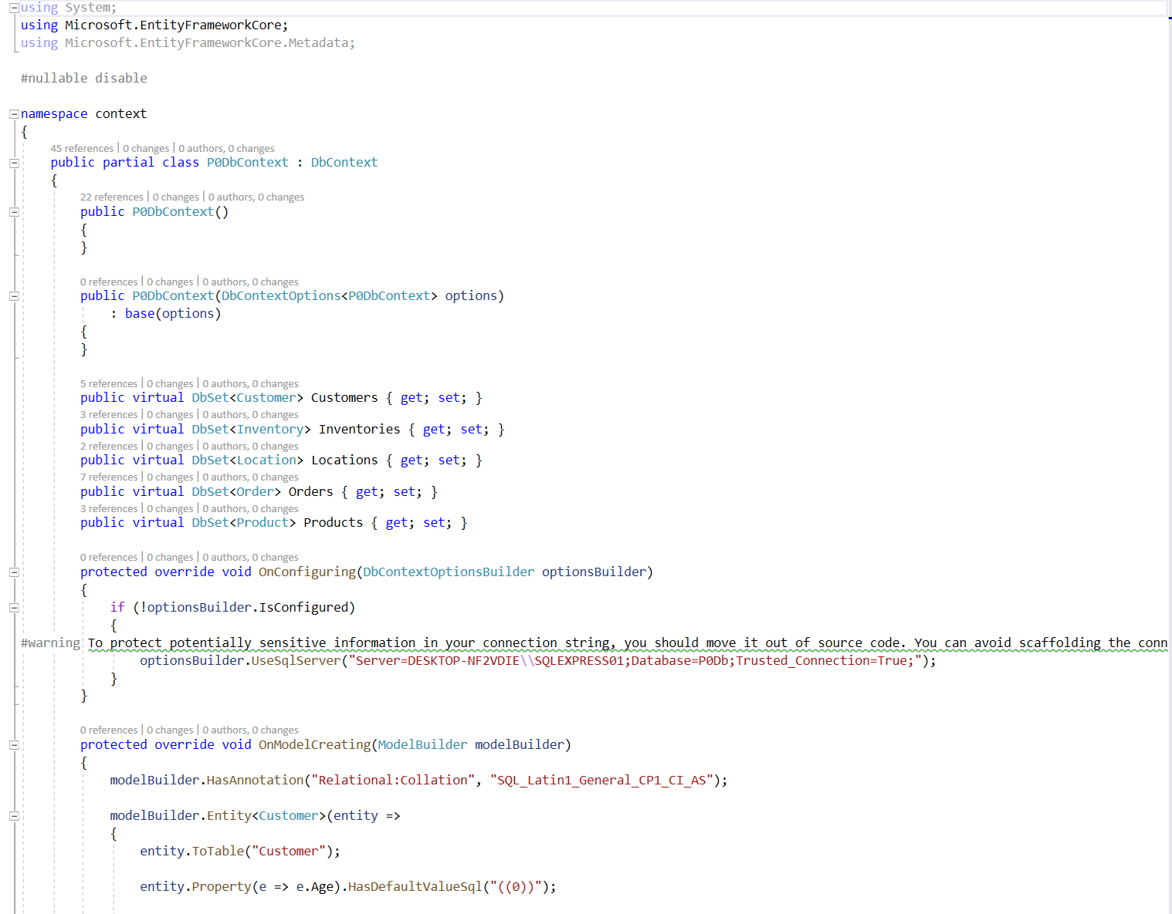
EF Core w/ Db 1st Approach
P0DbContext repo contains full Model builder

Slide 12
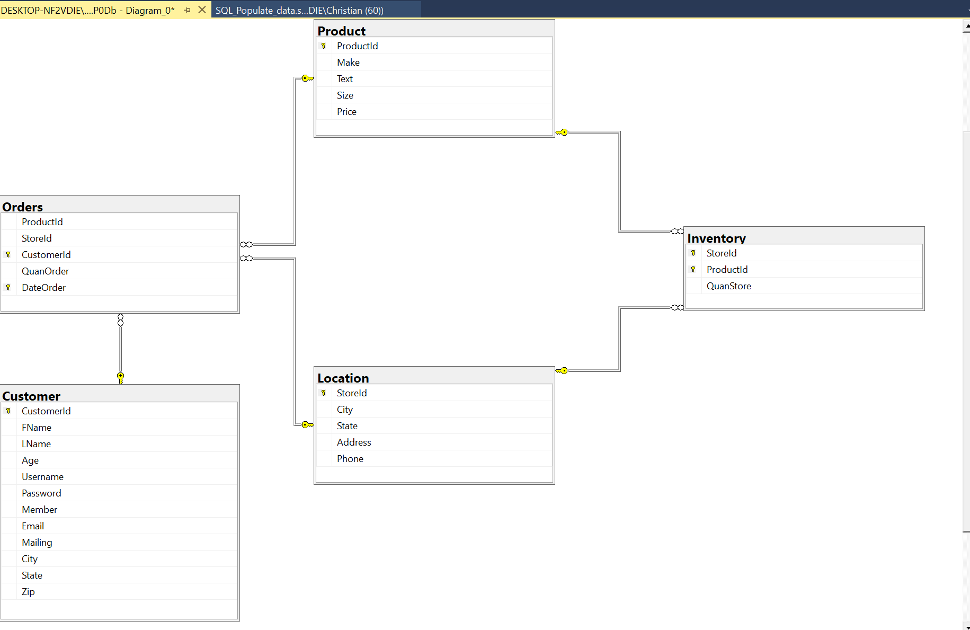
3NF

Slide 13
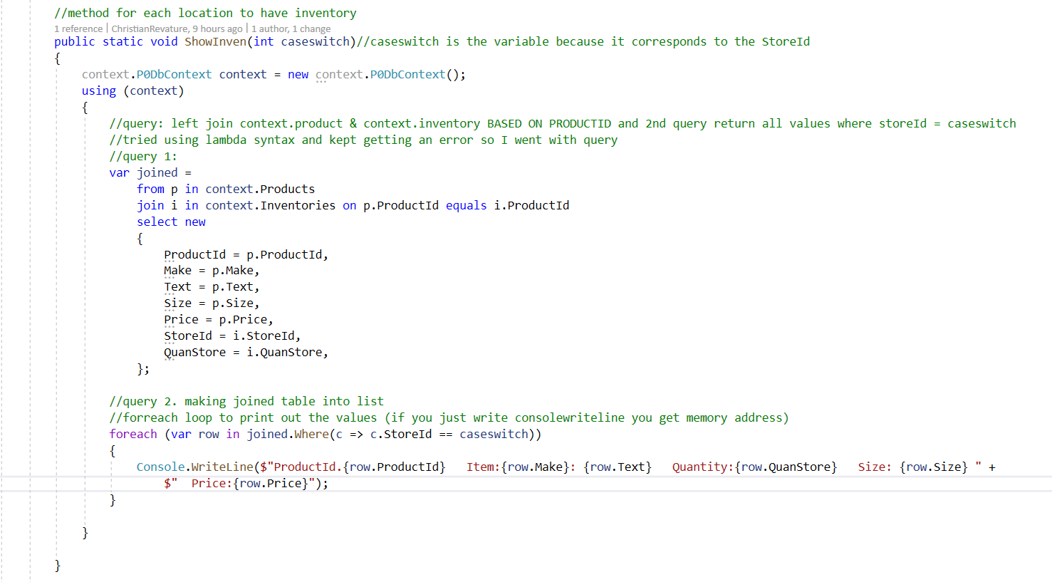
Locations have an inventory

Slide 14
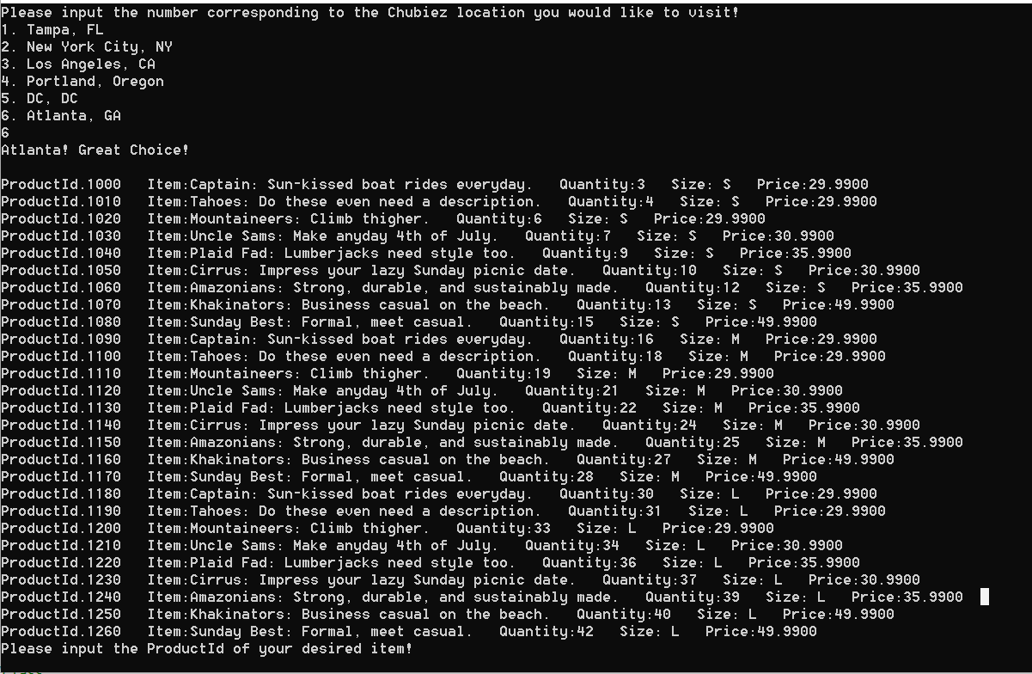
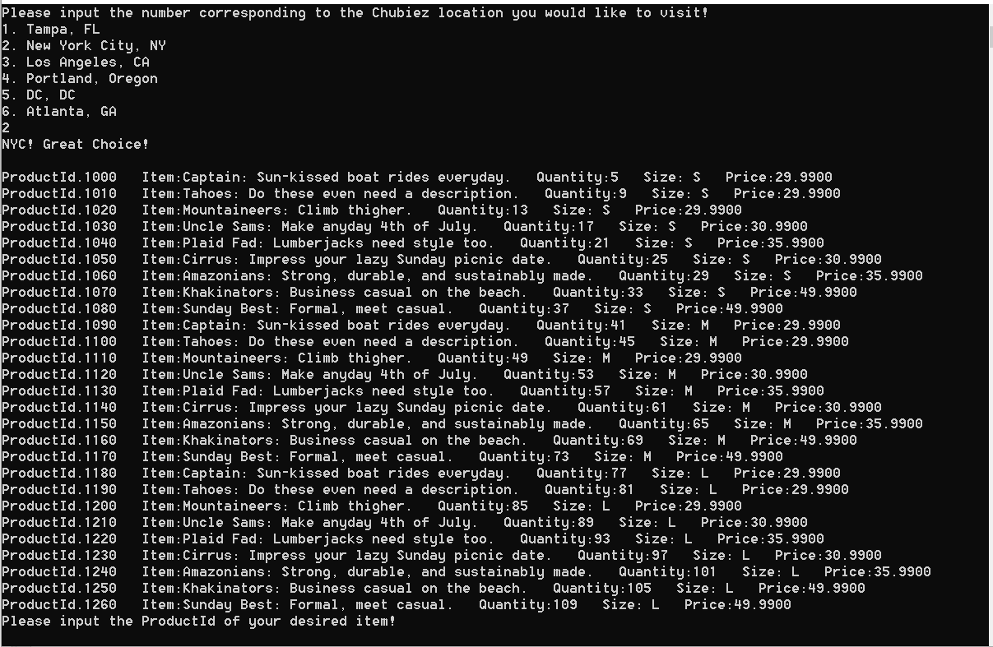
Locations have an inventory

Slide 15
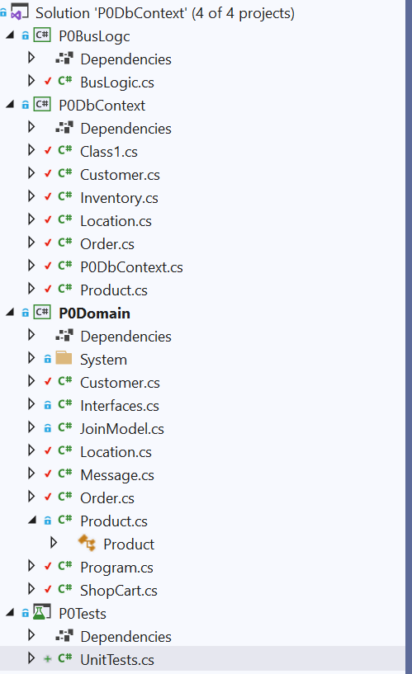
Solution Design

Slide 16
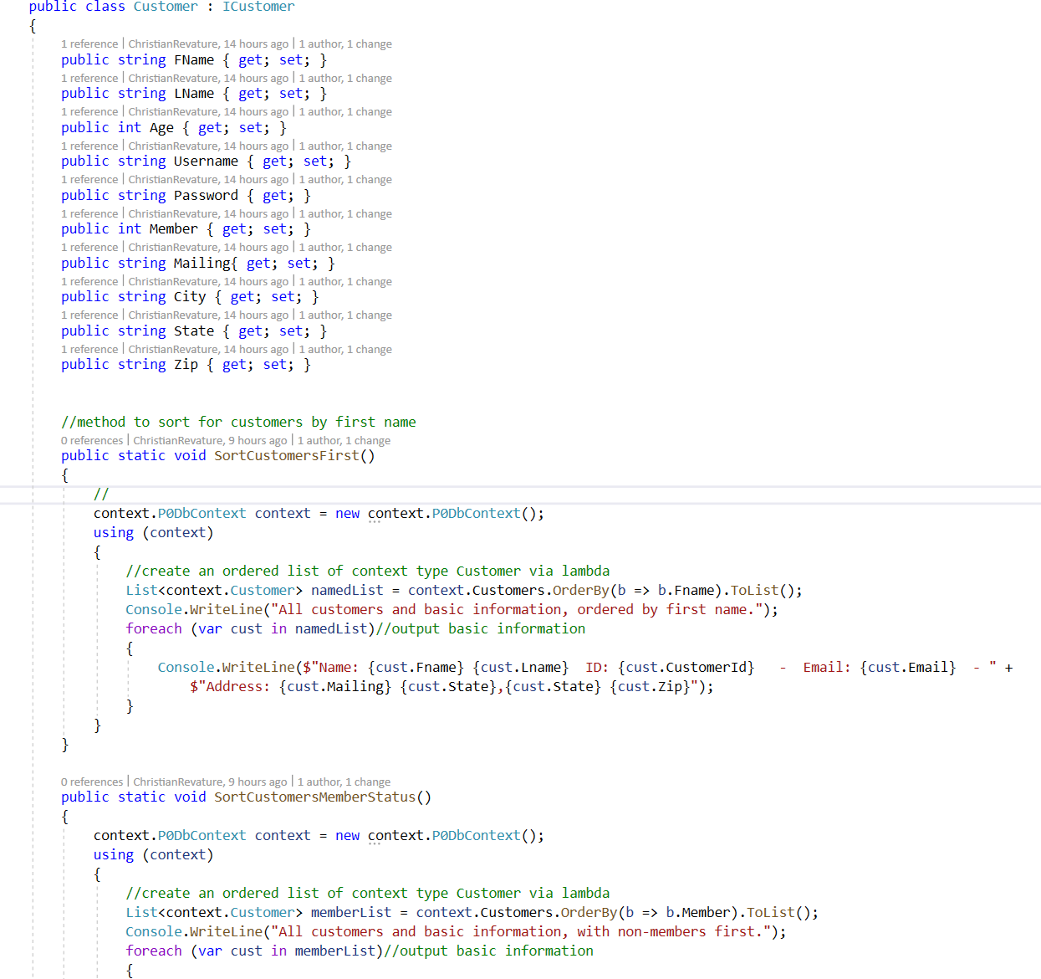
Interfaces

Slide 17
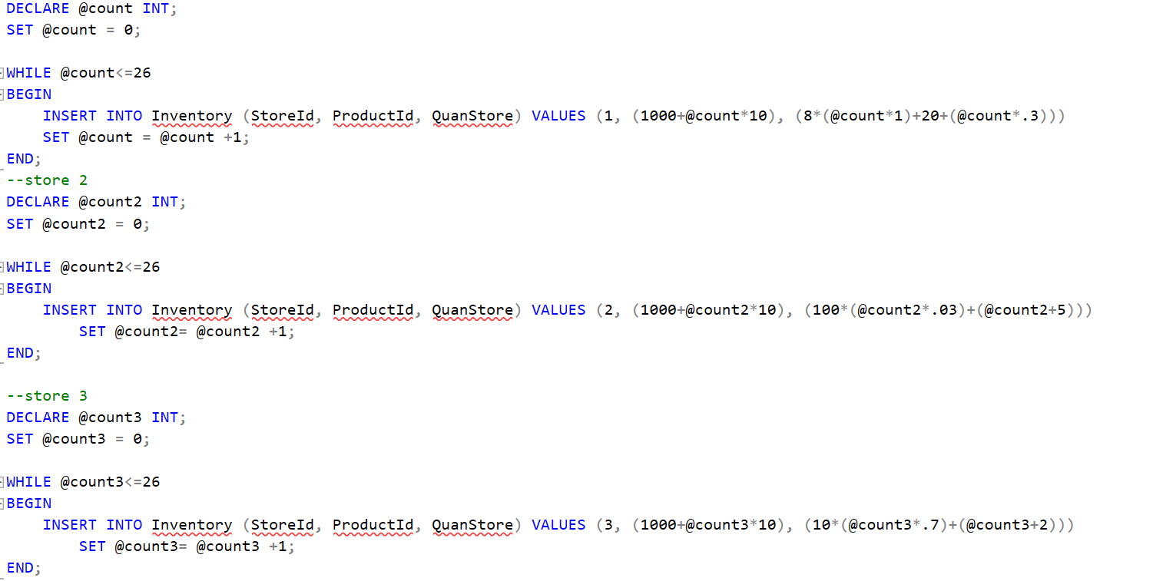
Persistent Data

Slide 18
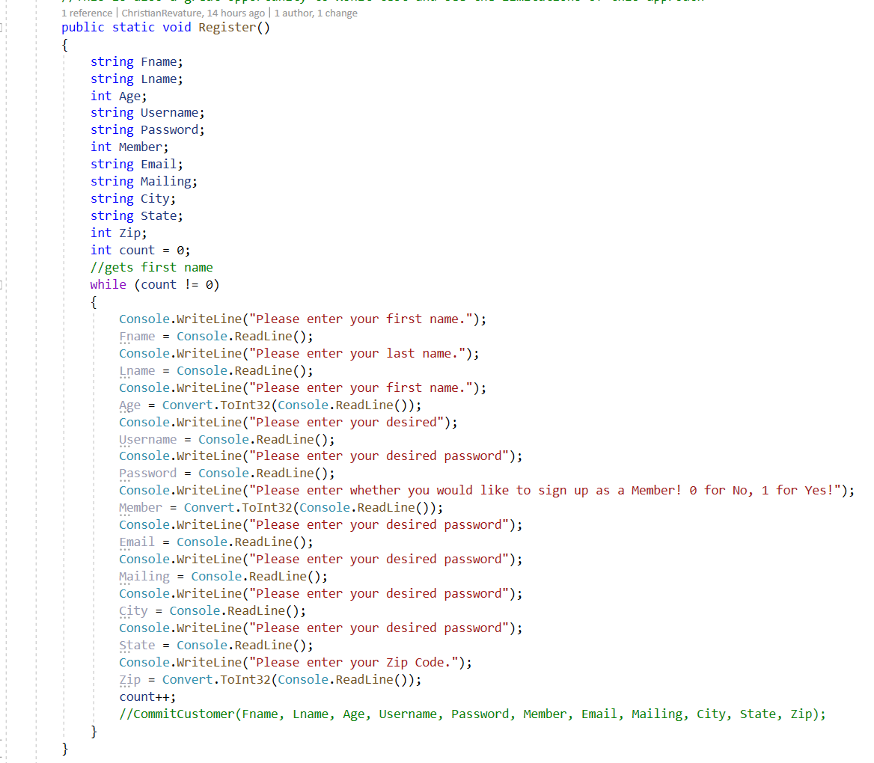
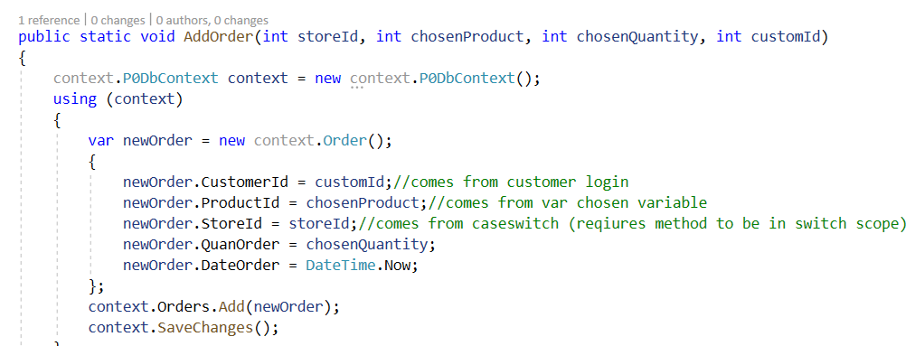
Persistent Data

